Slide 1
Project Request for Discovery
Prepared by: Shannon Perry
Submit to: Samantha Davies

Slide 2
Enterprise Consolidator Dashboard
Date: February 12, 2021

Slide 3
Project #: TBD | Project Owner: |  |  |  | Start Date: TBD |  |  |  |  | Target Release: TBD
Description: | This solution will allow us to play/grow our PS revenue in the consolidator market by providing our consolidator groups with a dashboard that shows data around usage and product performance for WebDVM, ClientEd & Sofie. It would be a new application that would pull from each of the solutions in one dashboard. Universal reporting for the consolidator, understand website traffic, conversion rates (form conversions), ClientEd article usage
Benefits & Justification | We want to go after the consolidator market for our PS solutions We lost a bid for an opportunity with NVA for WebDVM because we didn’t offer network wide reporting. Blue River has asked for network-wide reporting and data on WebDVM performance and VIP/PetIQ is asking for usage and data for their entire network on ClientEd.
Capex $ (M) TBD during Discovery – Do not fill in | 2021 Estimate: $ TBD during discovery |  |  | HW $: SW $: Int Labour $: |  |  |  |  |  | Incremental Opex Impact
Category – Check off all that apply |  | Regulatory/Mandatory | X | Efficiency |  | X |  | Reputation / Branding
 |  | Keep the Lights on | X | Revenue / Marketshare |  | X |  | Product Enhancement
High Level System Impacts | e.g. Sofie, NetSuite, Salesforce, ClientEd, Stratus, WebDVM, Reporting
Dependencies, Risks and Issues | Dependent on development timelines and workload Ability to pull data/metrics from existing solutions
Business Impacts – check areas that are affected from the implementation of the project | X | Finance | X | Marketing |  |  | X |  | Sales (Industry Solutions or Practice Sales?)
 | X | Industry Solutions |  | Infrastructure |  |  | X |  | Veterinary Affairs
 | X | Client Success | X | Software Development |  |  |  |  | Web Design
Impact of Delay in Schedule + Impact of doing/ not doing the project | Impact on consolidator target of $575k Impact on LifeLearn’s ability to play/grow in the consolidator market Impact of losing opportunity to grow VIP/PetIQ to 1000+

Slide 4
What does Success look like? How will success be measured? | A Dashboard to roll out by Q3 2021 to our existing consolidator groups Bring on additional consolidators on WebDVM, ClientEd and Sofie as a result of this dashboard
Target Audience of delivered Project | Business leads within the consolidator groups, Internal LifeLearn employees
Are there external contacts? | We may want include feedback from Blue River and VIP/PetIQ either through a mockup, beta testing etc.
Known Assumptions | Availability of resources to meet timelines
What is explicitly Out of Scope? | ALLYDVM, Petriage, PetNurse
What is the expected customer base, ramp up timeline or efficiencies as a result of the project? | Today it’s estimated that consolidators account for 10-15% of all practices in North America and expected to grow to 20-25% in the next 5 years. They have asked for this type of data to see how these solutions are working for their hospital and that it is worth the investment that they are making.

Slide 5
Detailed Project Scope
To create a cloud-based dashboard to show data on usage and product performance for WebDVM, ClientEd & Sofie. This new application will pull from each of the solutions in one dashboard, providing universal reporting on our solutions to our existing and future consolidator partners.

Slide 6
High Level Requirements
Dashboard Requirements:
Show data in numbers, totals, graphs and charts
Ability to export data in pdf and/or excel
Ability to see data for any or all 3 solutions (WebDVM, ClientEd & Sofie)
Ability to create multiple users under one account, not limited to a certain number of people.
Certain LifeLearn employees be able to log and view information as well.
Email and password. Double authentication
Ability to log in to see real time reporting
Ability to be filter data by Day/Week/Month/Quarter/Year
Log in a dashboard environment
Cloud based portal
Mobile responsive

Slide 7
High Level Requirements Cont’d
ClientEd Requirements: | Sofie Requirements: | WebDVM Requirements:
Utilization Report ClientEd Portal (Active/inactive users, Sessions, article searches, article views) (Vet staff by practice) Utilization Report WebDVM iFrame (article searches and article views) (pet owner by practice website) Top search queries (vet staff and pet owner) Top articles viewed (vet staff and pet owner) Top articles actioned by vet staff (Favorite, print, email) Usage by device (vet staff and pet owner) | Active Users Avg. Session Duration per User (Min) Sessions Avg. Sessions per User Searches Avg. Searches per User Article Views Avg. Article Views per User Show More Clicks Percent of Searches with Show More Clicks Compare Clicks Percent of Searches with Compare Clicks | Website Traffic SEO Results Top viewed pages Conversion Rates - Click to Dial, Conversion Form Submissions
Notes:
Previous ClientEd Reporting Requirements:
How many logins
By Hospital
By User Type
What keywords are being searched
Top 10 Viewed/printed Articles
Top 10 searches
Active Accounts/Inactive Accounts
How often would you like the reporting: Real time but the ability to filter by Week/Month/Year
Website views with iFrame code
Number of Logins
Hospital Name
Downloads
Emailed articles
Printed

Slide 8
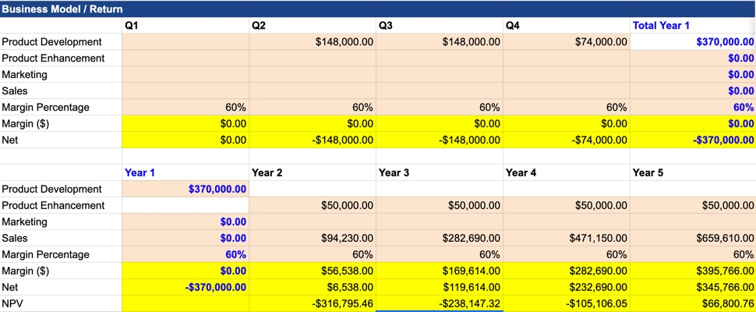
Expected Revenue

Slide 9
Next Steps
Submit this presentation to sdavies@lifelearn.com
Governance committee will book a discovery review session
Project will move to Concept Approval gate at SLT
If concept approved – Project Sponsor and Finance to work on Business Case if determined it is required, if not required Project team will begin requirements and solution to get to +/-10%
Project will go back to SLT for Project Approval

